Slide 1

01
Title
On-Board Integrated EV charger with reduced Switching loss and Improved Efficiency
Team Members:
ARUNPRASATH N (2127200601006)
BALASURIYA M (2127200601012)
DHAANYAAKUMAAR G S (2127200601018)
Internal Supervisor:
Dr.N. SHANMUGAVADIVU AP/EEE

Slide 2
MOTIVATION
02
Electric Vehicles (EVs) and Plug-in Hybrid Electric Vehicles (PHEVs) have drawn increasing interest from automakers, governments and consumers due to more strict laws on emissions, fuel economy, global warming, and resource limitations.
The recent development in infrastructure for charging electric vehicles includes both off-board and on-board chargers; off-board is a fast charger that delivers high power to DC outlets but has a high cost of production, moreover fast charging drastically affects battery life when compared to on-board charging.

Slide 3
OBJECTIVES OF PROJECT
03
Adopting the Bi-directional Zero voltage switching DC-DC converter for reduced switching loss and increased efficiency.
Eliminating the front end converter’s filter, by using the stator winding of traction motor as inductive filter.

Slide 4
LITERATURE SURVEY
04
NAME OF THE AUTHOR AND PAPER TITLE | NAME OF THE JOURNAL AND DOI | HIGHLIGHTS
Improved Power Quality On-Board Integrated Charger With Reduced Switching Stress Jyoti Gupta, Student Member, IEEE, Rakesh Maurya , Member, IEEE, and Sabha Raj Arya , Senior Member, IEEE | IEEE doi: 10.1109/TPEL.2020.2981955. | Typically, two conversion stage of an on-board charger is a front-end ac–dc voltage source converter with unity power factor correction feature followed by a dc–dc converter. The rectified output voltage (Vdc) of VSC is divided in two equal parts using split dc link capacitors (C1, C2) and fed to three-level bidirectional dc–dc converter.

Slide 5
LITERATURE SURVEY
05
NAME OF THE AUTHOR AND PAPER TITLE | NAME OF THE JOURNAL AND DOI | HIGHLIGHTS
On-Board Integrated Charger for Electric Vehicle Based on Split Three Phase Induction Motor Amol S. Kamble P. S. Swami Department of EEE Government Engineering College Aurangabad 431005. | IEEE, doi: 10.1109/ICETIETR.2018.8529144. | In split three-phase induction motor each phase winding carries same current, as well as each phase winding produced same magnetic field of the same magnitude but opposite in direction, so resultant is zero. Thus no RMF, no torque and motor simply work as an inductive filter during charging. The dual active bridge dc to dc converter used for controlling charging and discharging of the battery.

Slide 6
LITERATURE SURVEY
06
NAME OF THE AUTHOR AND PAPER TITLE | NAME OF THE JOURNAL AND DOI | HIGHLIGHTS
A Review of On-Board Integrated Charger for Electric Vehicles and A New Solution Tuopu Na Qianfan Zhang Jiaqi Tang Xue Yuan Harbin Institute of Technology Harbin, China | IEEE, doi: 10.1109/PEDG.2019.8807565 | Based on permanent magnet motor (PM) and induction motor (IM), the last type can also integrate both the converter and the motor windings. Two motor windings are used as filter inductors and two inverters are served as rectifier. The other two inverters and two windings are used as second stage dc/dc converter, which can control the output voltage.

Slide 7
LITERATURE SURVEY
07
NAME OF THE AUTHOR AND PAPER TITLE | NAME OF THE JOURNAL AND DOI | HIGHLIGHTS
A Novel ZVS Bidirectional Converter for Fuel Cell Electric Vehicle Driving System Dr. N.P.Subramaniam R.GoDepartment of Electrical and Electronics Engg Krishnasamy College of Engg and Tech, Caddalore-607109. | IEEE, doi: 10.1109/FAME.2010.5714856 | A soft switching implementation without additional device, high efficiency, simple control zero voltage switching (ZVS) bidirectional isolated DC-DC converter is presented in this paper. The proposed bi-directional DC-DC converter for fuel cell electric vehicle driving system. In the ZVS bidirectional DC-DC converter low-voltage side half-bridge with MOSFET and high voltage side half bridge with IGBT were developed.

Slide 8
PROJECT DESCRIPTION
08
For applications involving the battery charging of vehicles, there is a constant need for on-board chargers that are dependable, effective, compact and lightweight.
Integrated chargers are created employing the idea of hardware reuse in order to increase the power level of the on-board chargers.
By integrating the charger component with the propulsion circuitry, on-board battery chargers can reduce their weight, volume, space and cost. It is possible to use the EV's traction components in the charging circuit because they are not activated during the charging process.

Slide 9
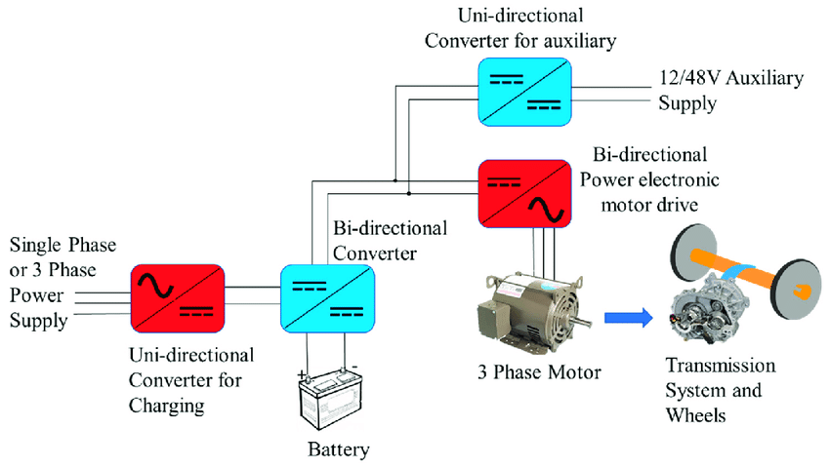
CONVENTIONAL ON-BOARD CHARGER
09
(a)

Slide 10
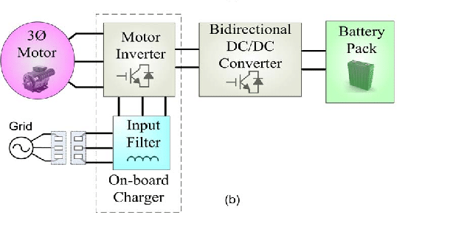
INTEGERATED ON-BOARD CHARGER
10

Slide 11
PROJECT DESCRIPTION
11
The stator windings of three-phase traction AC motor can be used as a grid interfacing inductor filter at the front end AC to DC converter during the charging mode.
The PWM voltage source converter and the bidirectional dc-dc converter are both used while charging. When the system is in drive mode, the PWM scheme is employed to provide the desired motor speed and torque.
The proposed system comes with three-level Zero voltage switching (ZVS) bidirectional dc–dc converter which will reduce the switching losses and will increase the overall system efficiency.

Slide 12
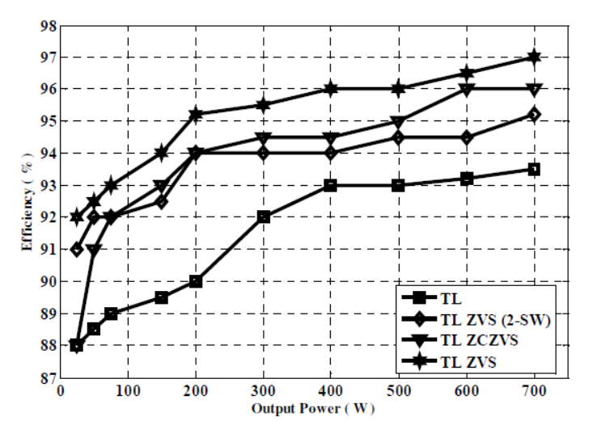
COMPARISION OF CONVERTERS
12

Slide 13
BLOCK DIAGRAM
13
CHARGING MODE
3 PHASE STATOR WINDING OF AC MOTOR
BIDIRECTIONAL AC-DC CONVERTER
(RECTIFIER)
AC SOURCE
BATTERY
BIDIRECTIONALZVS DC-DC CONVERTER

Slide 14
BLOCK DIAGRAM
14
TRACTION MODE
AC MOTOR
BIDIRECTIONAL AC-DC CONVERTER
(INVERTER)
TRANSMISSION
BATTERY
BIDIRECTIONALZVS DC-DC CONVERTER

Slide 15
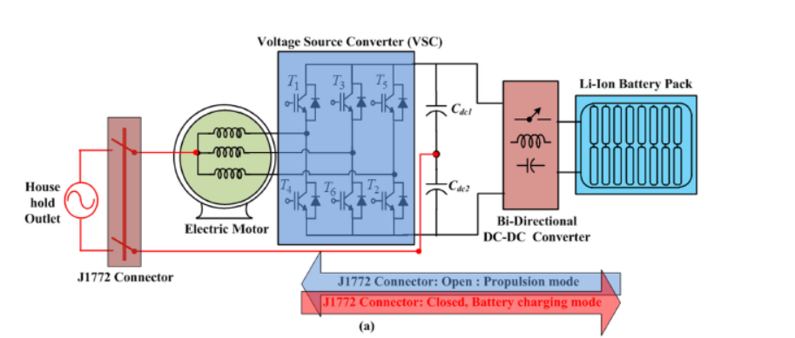
PROJECT DESCRIPTION
15
PROPOSED MODEL

Slide 16
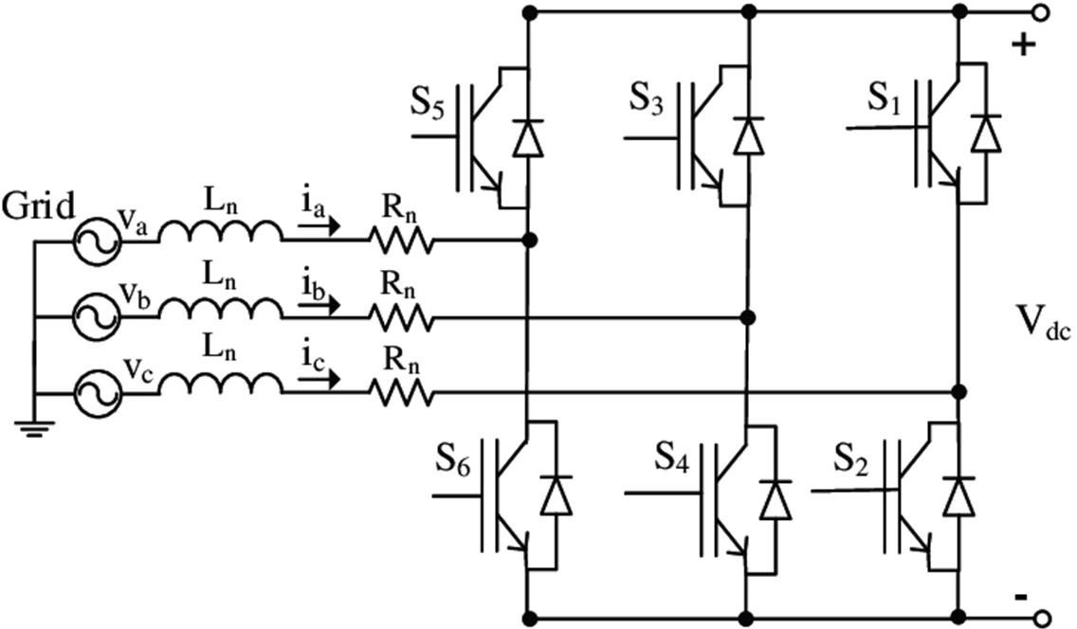
BI-DIRECTIONAL AC-DC CONVERTER
16
A bidirectional AC-DC PWM (Pulse Width Modulation) converter is a power electronic device that can operate in both rectification (AC to DC) and inversion (DC to AC) modes. These converters are commonly used in applications where power needs to flow bidirectionally, such as in energy storage systems, electric vehicles, and grid-tied renewable energy systems.

Slide 17
MODES OF OPERATION
17
Rectification (AC to DC)
During rectification, the bidirectional AC-DC converter converts AC power from the source (grid) into DC power for storage or use in a DC load. This process typically involves a rectifier circuit, which can be implemented using diodes, thyristors, or controlled rectifier circuits.
Inversion (DC to AC)
In inversion mode, the bidirectional converter converts stored DC power into AC power. This is essential in applications such as grid-tied inverters, where stored energy needs to be fed back into the AC grid. Inversion is accomplished using an inverter circuit, often employing switches like Insulated Gate Bipolar Transistors (IGBTs) for high-power applications.

Slide 18
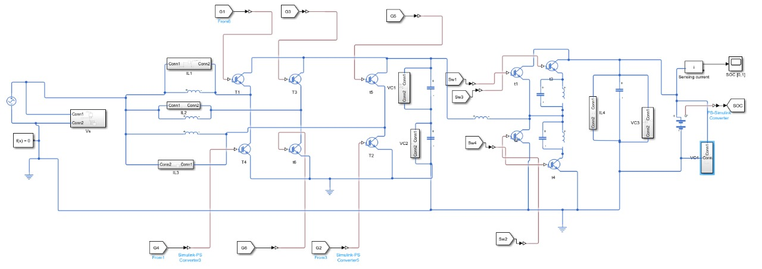
PROPOSED SIMULINK MODEL
18

Slide 19
DESIGN PARAMETERS
19
AC SOURCE
PEAK AMPLITUDE – 230V
FREQUENCY – 50HZ
DESIGN OF BIDIRECTIONAL AC-DC
INDUCTANCE – 10e-6H
CAPACITANCE – 4700e-6F
DESIGN OF ZVS
INDUCTANCE – 5e-6H
CAPACITANCE – 4700e-6F

Slide 20
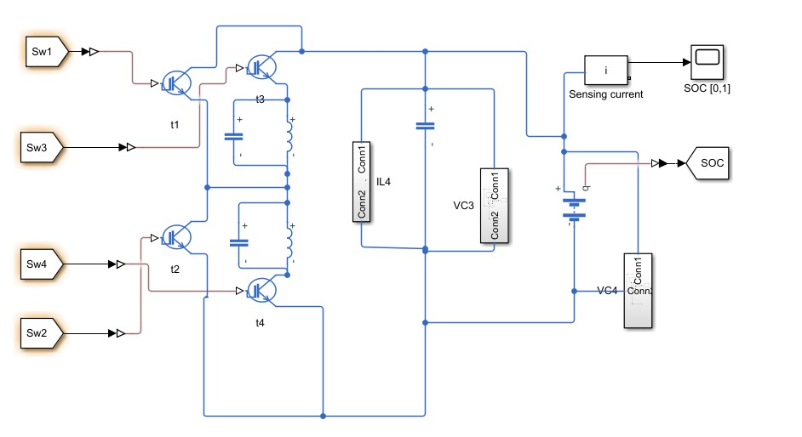
SIMULINK MODEL OF ZVS CIRCUIT
20

Slide 21
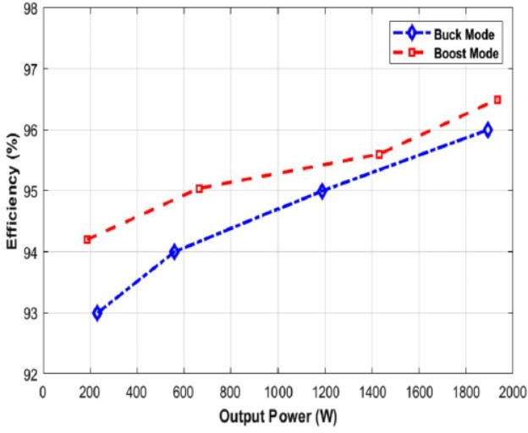
EFFICIENCY OF ZVS CONVERTER
21

Slide 22
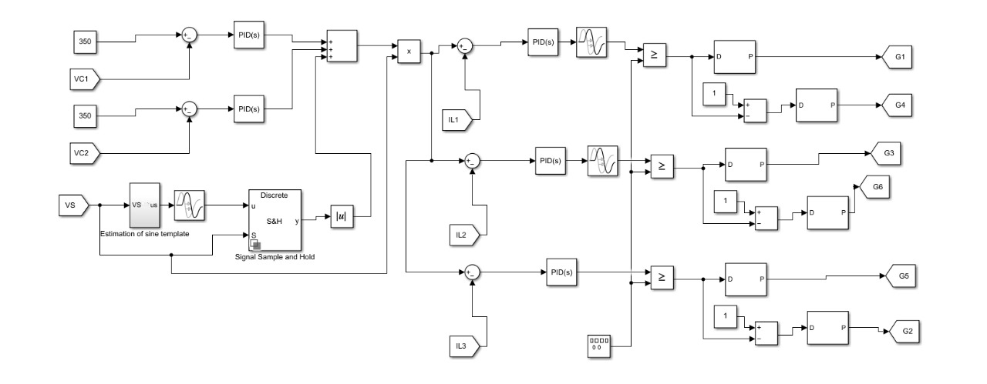
INTERLEAVED BOOST CONVERTER
22

Slide 23
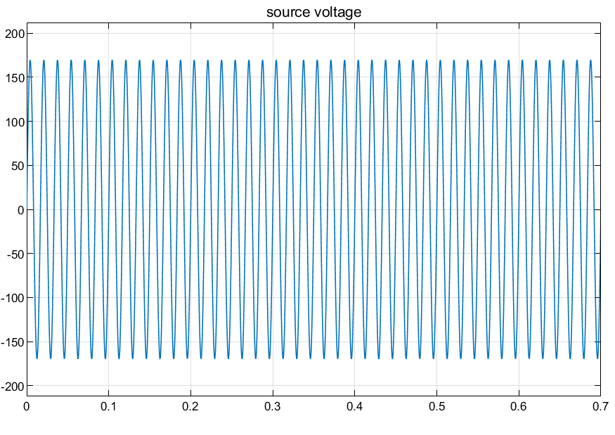
INPUT WAVEFORM
23

Slide 24
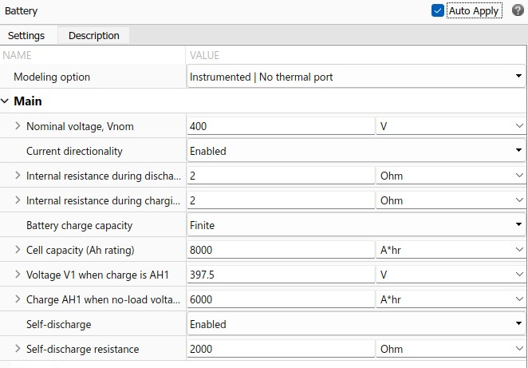
BATTERY SPECIFICATIONS
24

Slide 25
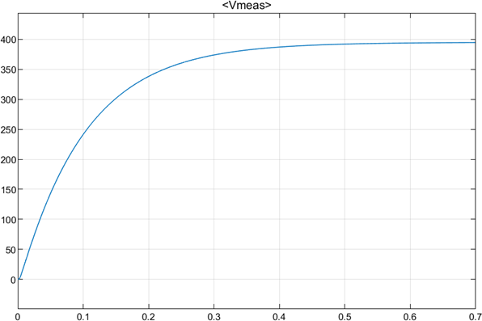
BATTERY NOMINAL VOLTAGE
25

Slide 26
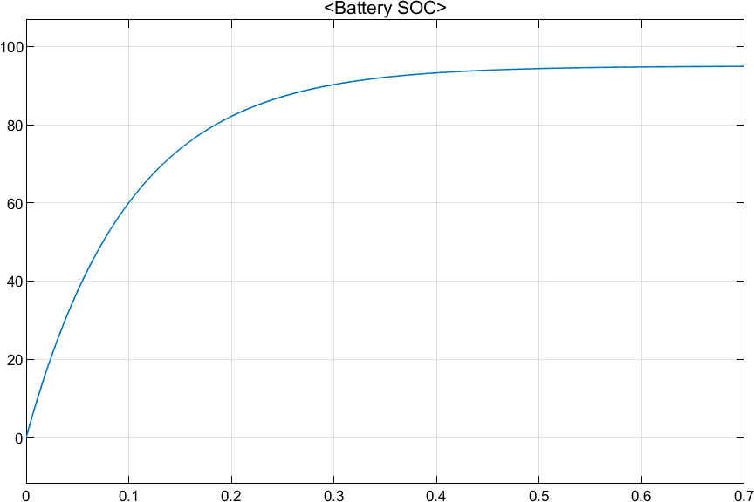
STATE OF CHARGE
26
The Battery State of Charge (SoC) in Electric Vehicles (EVs) represents the remaining energy as a percentage of the total battery capacity. It is a crucial parameter for EV management systems, informing drivers about the available driving range.

Slide 27
RESULTS
27
The Total Harmonic Distortion of the source current with 230V as input voltage is calculated to be 3% with conventional converters. The THD in the presented model is found to be 2.8%.
The switching loss of the conventional bidirectional DC-DC converter is found to be 0.24W. The switching loss of the ZVS bidirectional DC-DC converter is found to 0.03W.
Thus using the ZVS converter reduces the switching losses in the system and which results in increase of efficiency compared to the conventional model using three level DC-DC converter.

Slide 28
PLAN OF ACTION
28
TASK NAME | JULY |  | AUGUST |  |  |  | SEPTEMBER |  |  |  | OCTOBER
 | WEEK 3 | WEEK 4 | WEEK 1 | WEEK 2 | WEEK 3 | WEEK 4 | WEEK 1 | WEEK 2 | WEEK 3 | WEEK 4 | WEEK 1 | WEEK 2 | WEEK 3 | WEEK 4
Title Search
Literature Survey
Initialization of simulation
Modelling of Components
Validation of simulation output
Thesis writing

Slide 29
REFERENCES
29
Bhajana, VVSK., Drabek, P., Jara, M., Popuri, M., Iqbal, A., Chitti, Babu B. (2021) ‘Investigation of a bidirectional DC/DC converter with zero-voltage switching operation for battery interfaces’, doi.org/10.1049/pel2.12048.
De Sousa, L., Silvestre, B. and Bouchez, B. (2010) ‘A combined multiphase electric drive and fast battery charger for Electric Vehicles’ pp. 1-6, doi: 10.1109/VPPC.2010.5729057.
Gupta, J., Maurya, R. and Arya, S.R. (2020) ‘Improved Power Quality On-Board Integrated Charger With Reduced Switching Stress’ vol. 35, no. 10, pp. 10810-10820, Oct. 2020, doi: 10.1109/TPEL.2020.2981955.
Kamble, A.S. and Swami, P.S. (2018) ‘On-Board Integrated Charger for Electric Vehicle Based on Split Three Phase Induction Motor’, pp. 1-5, doi: 10.1109/ ICETIETR.2018.8529144.
Na, T., Yuan, X., Tang, J. and Zhang, Q. (2019) ‘A Review of On-Board Integrated Charger for Electric Vehicles and A New Solution’ pp. 693-699, doi: 10.1109/PEDG.2019.8807565.
Pellegrino, G., Armando, E. and Guglielmi, P. (2010) ‘An Integral Battery Charger With Power Factor Correction for Electric Scooter’ vol.25, No.3, pp.751-759, doi: 10.1109/TPEL.2009.2033187.
Raju, R.G.G. and Subramaniam, N.P. (2010) ‘A novel ZVS bidirectional converter for fuel cell electric vehicle driving system’ pp. 339-343, doi: 10.1109/FAME. 2010.5714856.
Sharma, S., Aware, M.V. and Bhowate, A. (2020) ‘Integrated Battery Charger for EV by Using Three-Phase Induction Motor Stator Windings as Filter’ vol. 6, no. 1, pp. 83- 94, doi: 10.1109/TTE.2020.2972765.

Slide 30

30

